Slide 1
CPSC3300: Computer Systems Organization
Lecture 7 – Sequential Logic

Slide 2
Administrivia
Exam 1
Thursday 2/11
Covers material introduced by Tuesday 2/9 (Lecture 8 - Example Devices and Finite State Machines)
Readings, homework assignments, textbook, slides
Homework 2 (Boolean Algebra & Adders) available
Due Monday 2/8 at 11:59pm
Today
Sequential logic and devices
Reading: 8.7-8

Slide 3
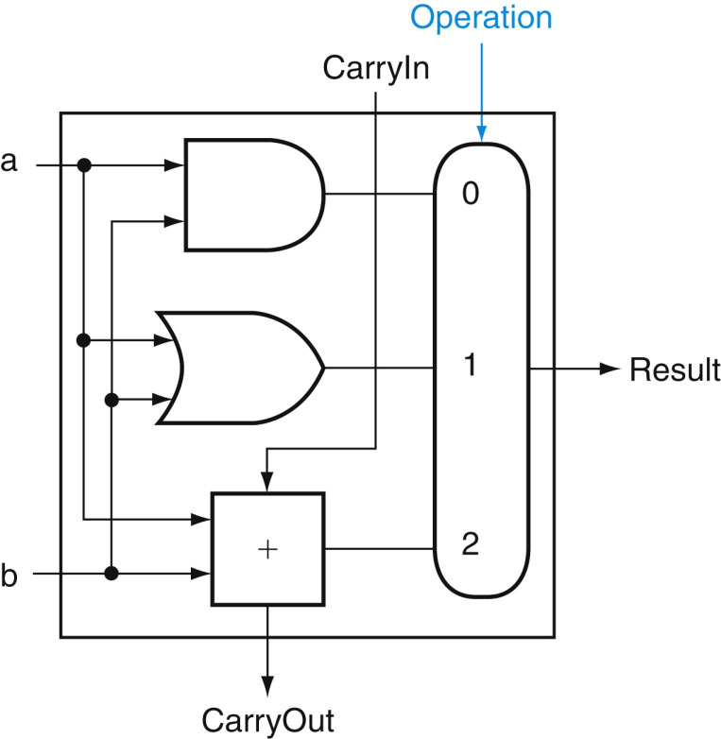
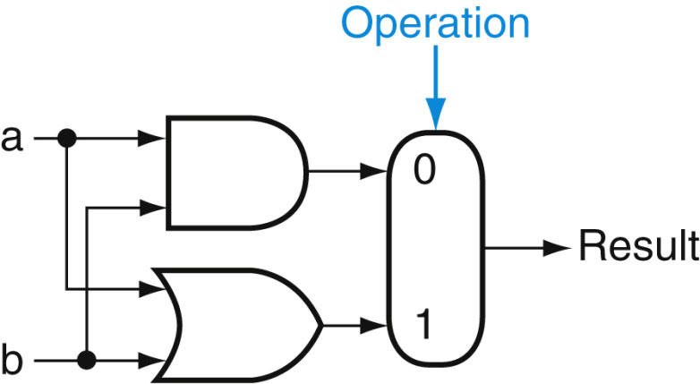
ALU
ALU
Arithmetic Logic Unit
Arithmetic operations: +, -, *, /, %
Logic operations: AND, OR, NOT, XOR
The 1-bit logical unit for AND and OR
The 1-bit ALU for AND, OR, and addition

Slide 4
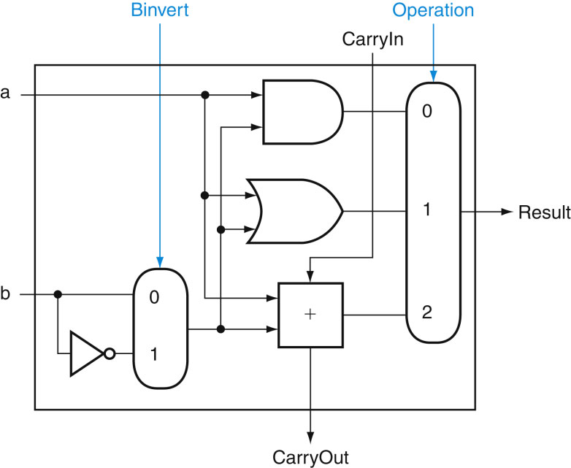
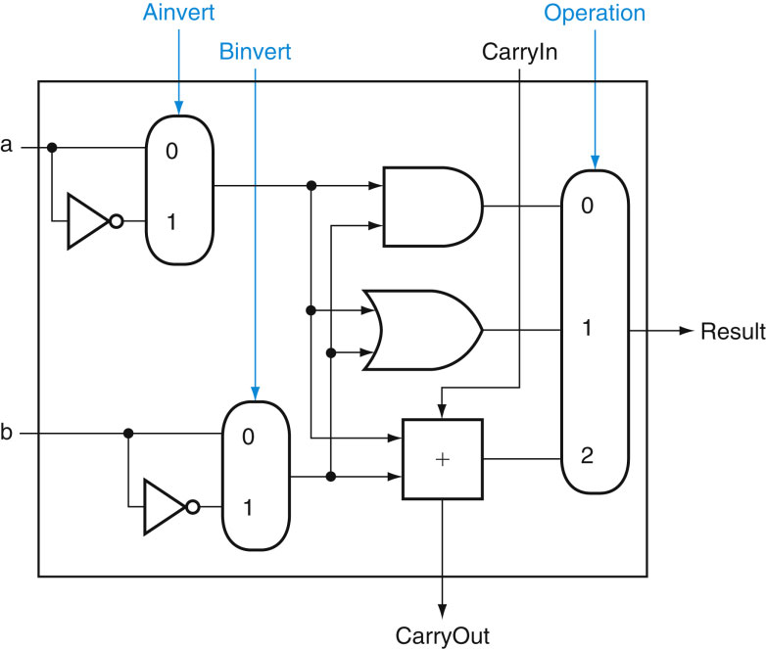
1-bit ALU
Support on (a, b), (a, not b)
AND
OR
Addition
Support on (a, b), (a, not b), (not a, b), (not a, not b)
AND
OR
Addition

Slide 5
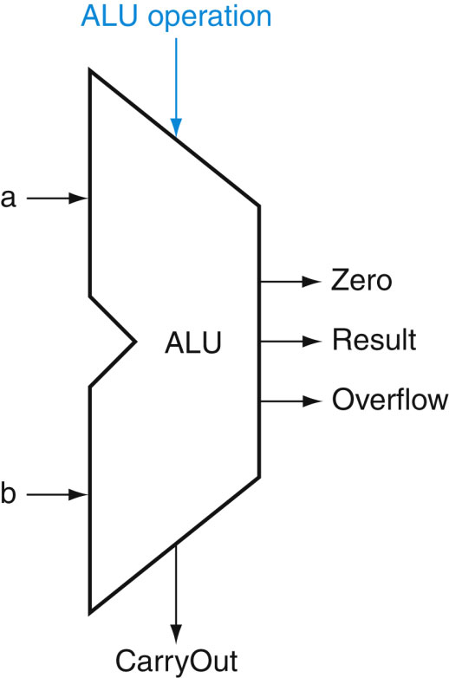
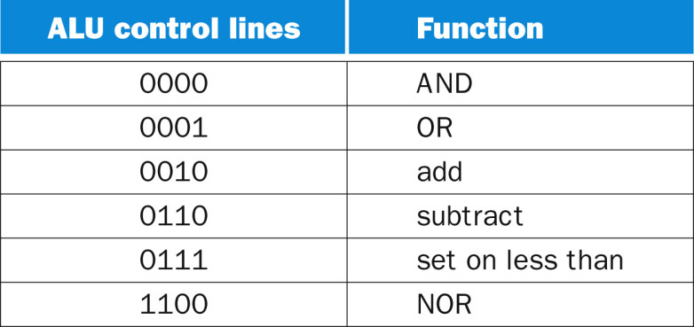
ALU

Slide 6
Combinational Logic Circuits
So far, we learned about combination logic
Combinational logic circuits
Have inputs and outputs
Implement Boolean functions and mathematical operations
Output depends only on present inputs.
Example:
Input 000 → combinational logic circuits → 100 (fixed mapping)

Slide 7
What is State?
Mathematical functions are stateless
take inputs, and produce the corresponding outputs.
do not store information or data
Definition of state:
State is a quantity that stores the previous history of what's happened in such a way that you can predict the output, given any future input.

Slide 8
Sequential Logic Circuits
Sequential logic circuits
Contains one or more combinational logic blocks
Have state in a feedback loop with the logic
use a clock.
The next state depends on the inputs and the present state
The output depends on the present state and perhaps also the inputs
Sequential logic circuits have memory

Slide 9
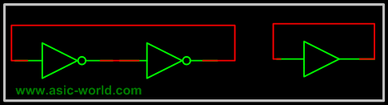
A Basic Two-Inverter Element
A memory cell:
Two inverters connected back-to-back, i.e. output of one to input of the other and vice-versa.
Using feedback to store the value or hold the value.
Two stable states
V01 = 0 and V02 =1
V01 = 1 and V02 = 0
v01
v02
v01
v02

Slide 10
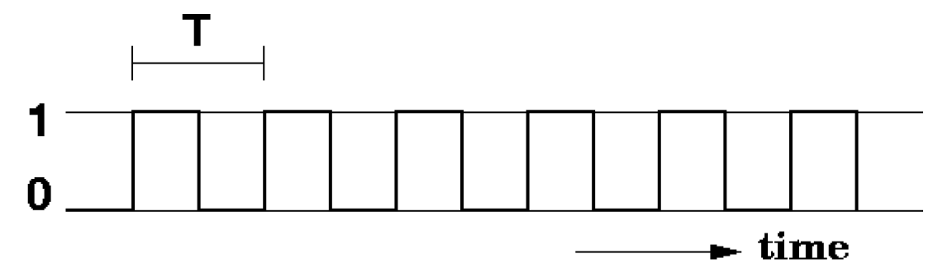
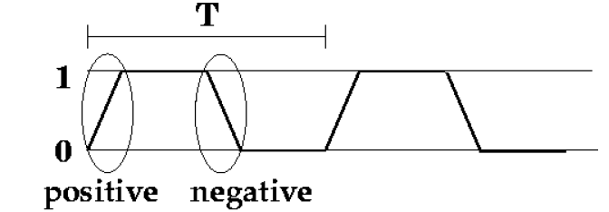
Clock and Clock Edges
Timing diagram is used to describe the behavior of a clock
Very small transition time: 0 -> 1 and 1 -> 0.
Positive edges: the clock transitions from 0 to 1
Negative edges: the clock transitions from 1 to 0
Why are clock edges important
Flip flops and registers are timed devices and triggered by edges.
Why flip flops are built this way?
Time on X, voltage on y
exaggerated transitions

Slide 11
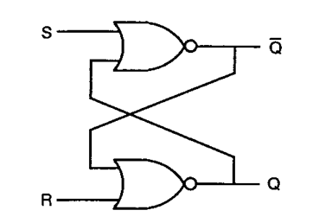
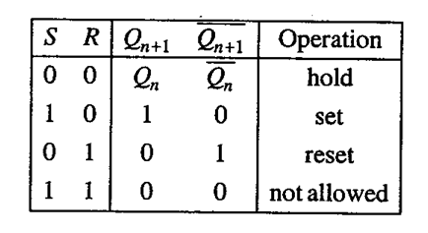
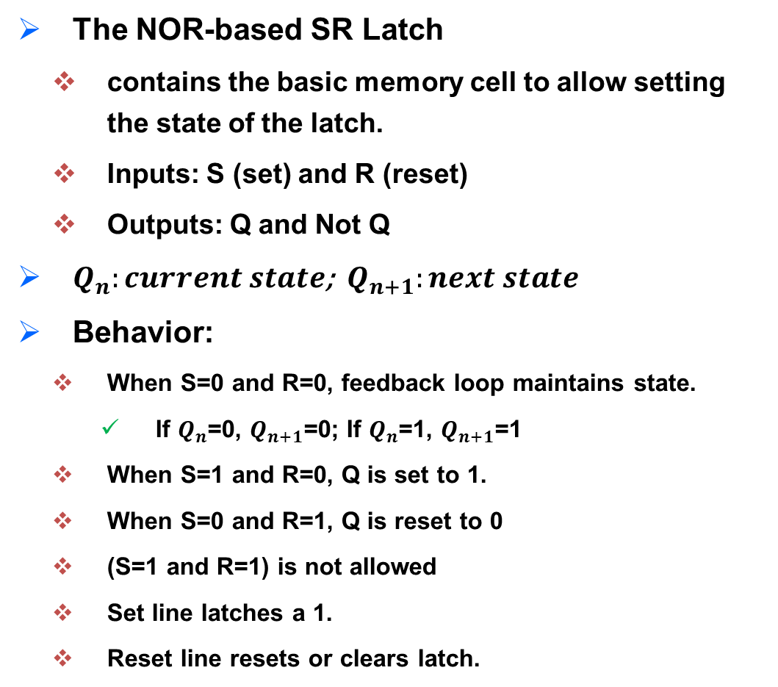
SR Latch
The NOR-based SR Latch
contains the basic memory cell to allow setting the state of the latch.
Inputs: S (set) and R (reset)
Outputs: Q and Not Q
$Q_{n}:current state$; $Q_{n+1}:next state$
Behavior:
When S=0 and R=0, feedback loop maintains state.
If $Q_{n}$=0, $Q_{n+1}$=0; If $Q_{n}$=1, $Q_{n+1}$=1
When S=1 and R=0, Q is set to 1.
When S=0 and R=1, Q is reset to 0
(S=1 and R=1) is not allowed
Set line latches a 1.
Reset line resets or clears latch.

Slide 12
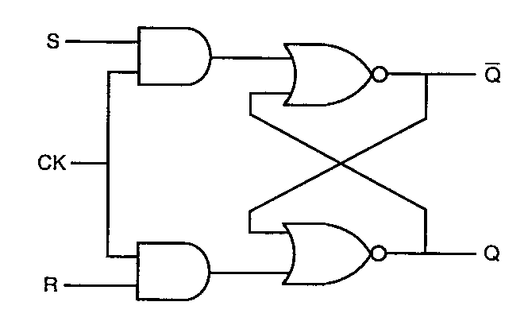
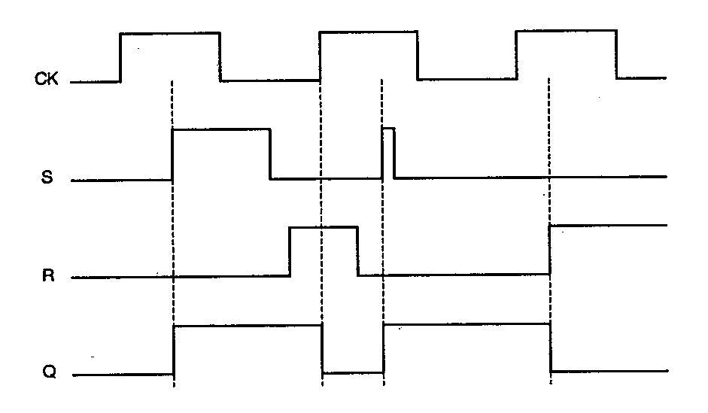
Clocked SR Latch
The NOR-based SR latch with a clock added.
The latch is responsive to inputs S and R only when CLK is high (level)
When CLK is low, the latch retains its current state
Timing diagram shows the level-sensitive nature of the clocked SR latch.
Note four times where Q changes state:
When S goes high during positive CLK
On leading CLK edge after changes in S & R during CLK low time
A positive glitch in S while CLK is high
When R goes high during positive CLK
S
Q
CLK
R
Q

Slide 13
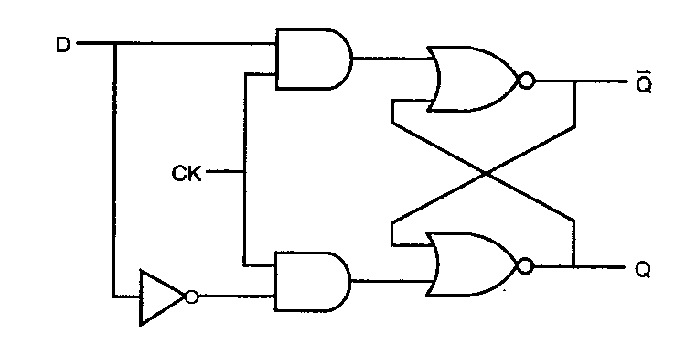
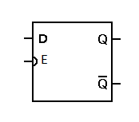
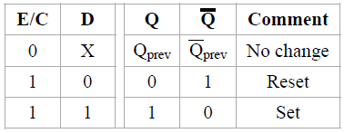
D Latch
Data latch, simply D Latch
A D-latch is implemented with
a clocked, NOR-based S-R latch
D connected to S
Inverted D connected to input R
Behavior
When CLK is high, D is transmitted to output Q (and D’ to Q’)
When CLK is low, the latch retains its previous state
Transparent latches are typically used as I/O ports or in asynchronous systems, or in synchronous two-phase systems

Slide 14
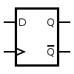
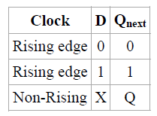
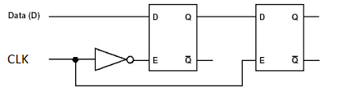
Edge-Triggered D Flip-Flops
Synchronous sequential circuits –inputs captured at only discrete instants of time, such as the rising edges of the clock.
Latches are level-triggered, not practical for use in synchronous sequential circuits.
Behavior:
Rising edge: sample input D and direct it to Qnext
If D=0 then Qnext=0; if D=1 then Qnext=1
Non-rising edge, Qnext=Q, no matter what value input D is.
A D flip-flop can be viewed as a memory cell.
Positive Edge Triggered D Flip-Flops

Slide 15
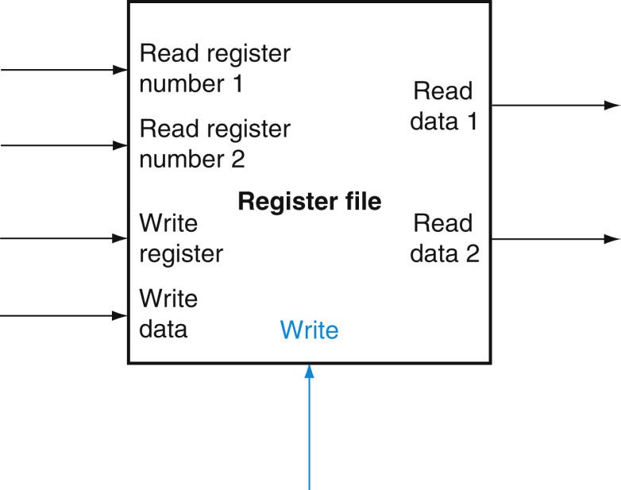
Register File
Register file: a set of registers that can be read and written by supplying a register number to be accessed

Slide 16
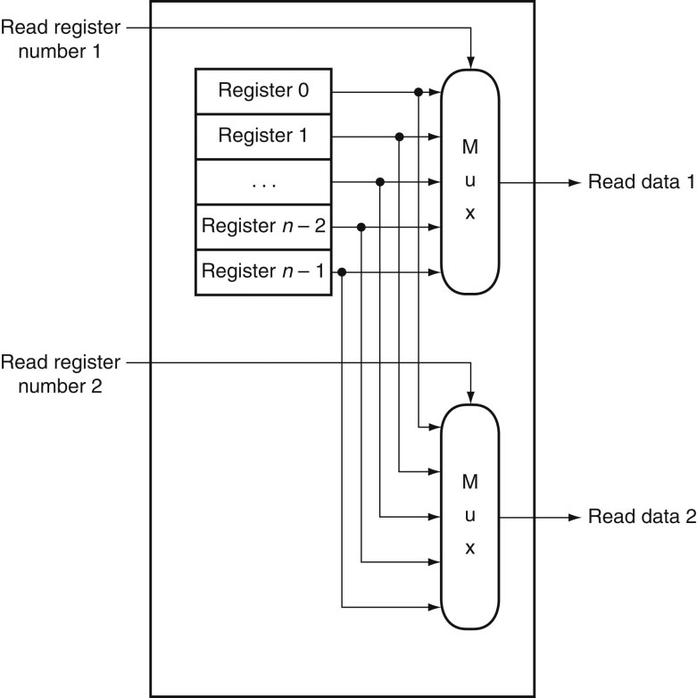
FIGURE B.8.8 The implementation of two read ports for a register file with n registers can be done with a pair of n-to-1 multiplexors, each 32 bits wide. The register read number signal is used as the multiplexor selector signal. Figure B.8.9 shows how the write port is implemented.
16
Copyright © 2014 Elsevier Inc. All rights reserved.

Slide 17
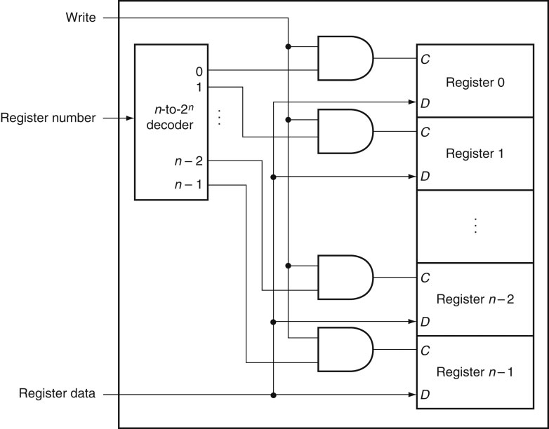
FIGURE B.8.9 The write port for a register file is implemented with a decoder that is used with the write signal to generate the C input to the registers. All three inputs (the register number, the data, and the write signal) will have setup and hold-time constraints that ensure that the correct data is written into the register file.
17
Copyright © 2014 Elsevier Inc. All rights reserved.

Slide 18
Administrivia
Exam 1
Online via Canvas
Exam is open-notes
Thursday February 11
HW1 solution will be available on Canvas, HW2 questions will be explained during the review session before the exam
Sample questions will be available on Canvas

Slide 19
Summary
Difference between combinational and sequential logics
ALU
Feedback circuits
Latches
Flip-flops
Reading for next lecture
8.10

